Slide 1


Vrinda Store Data Analysis Project
📊 Data-Driven Insights: Boosting Sales Performance 🚀
Table Of Contents:
Define Objective
Data Gathering
Data cleaning
Data Processing
Data Visualization
Insights
Using MS Excel
Shamayita Das

Slide 2


Define Objective
This project's goal is to examine Vrinda Store sales data in order to produce an annual sales report for 2022. to better understand their clients and increase sales in 2023 at Vrinda. The analysis will try to provide answers to issues like:
What are the most popular categories?
Which marketing channel is generating the most revenue?
Which month saw the most in terms of orders and sales? How will order status change in 2022?
What are the top 10 states that contribute to sales?
Who will make more purchases in 2022, men or women?
In order to help Vrinda Store grow revenue and improve customer happiness, the project intends to give insights that can guide decision-making for marketing, product development, and sales tactics.

Slide 3
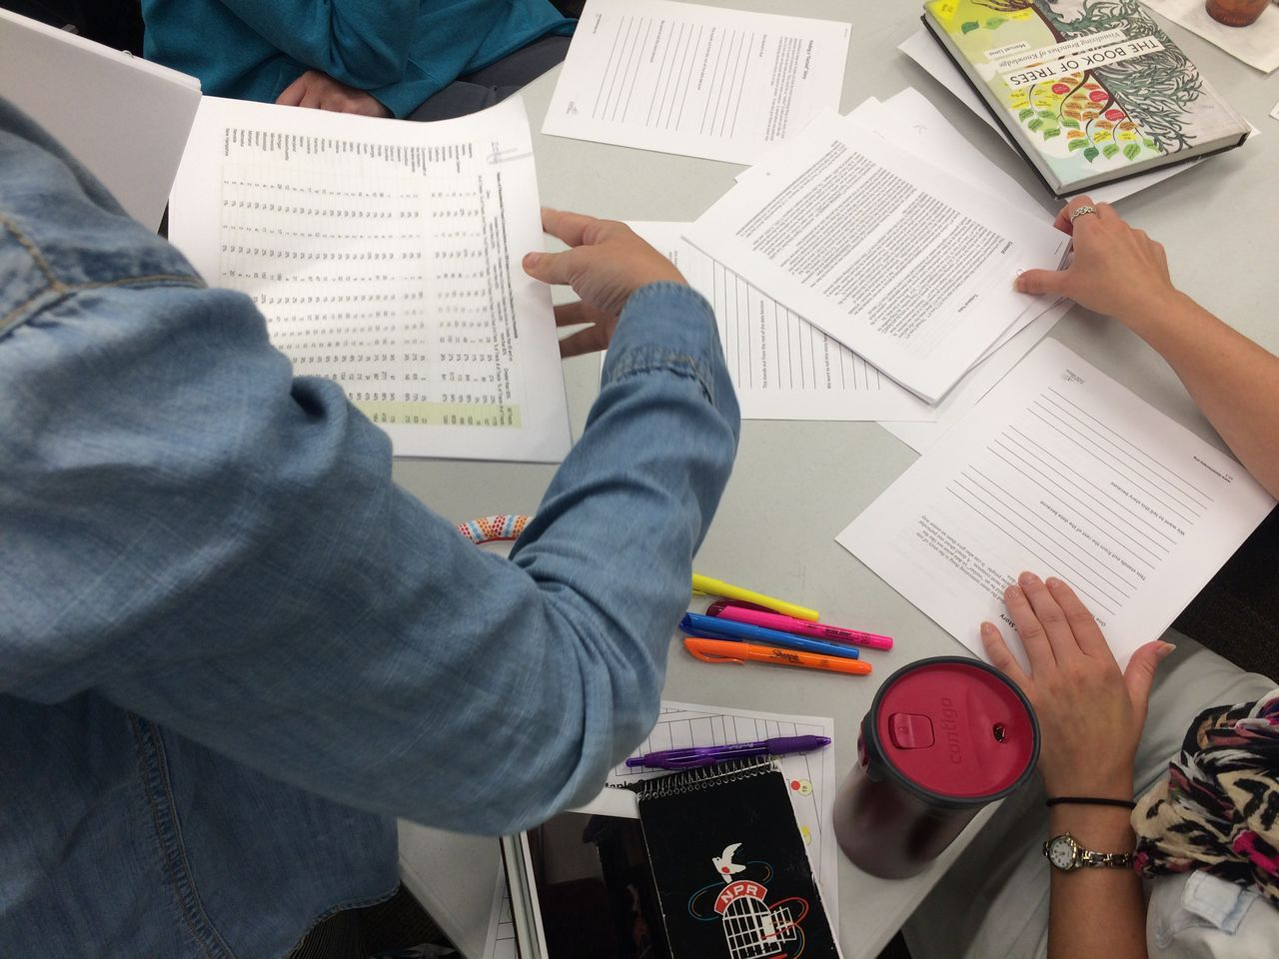

Data Gathering
Once your goal has been determined, you must come up with a plan for gathering and combining the necessary data. Choosing the data you require is a crucial component of this. These could be qualitative (descriptive) data, like customer reviews, or quantitative (numeric) data, like sales figures.
Data source for this project is: https://docs.google.com/spreadsheets/d/1N_Aa45UnkPmnwGqNr6oTzvUhb5TKlitM/edit#gid=1081836936

Slide 4


Data cleaning
1. Get rid of significant errors, duplication, and outliers—all issues that always arise when combining data from several sources.
2. Eliminating unnecessary observations that have no influence on your desired analysis—removing unneeded data points.
4. Filling in significant gaps—while you're organizing, you can find that crucial facts are missing. You can start filling holes once you've found them.
3. Giving your data structure—general "housekeeping," such as correcting typos or layout flaws, which will make it easier for you to map and handle your data.

Slide 5
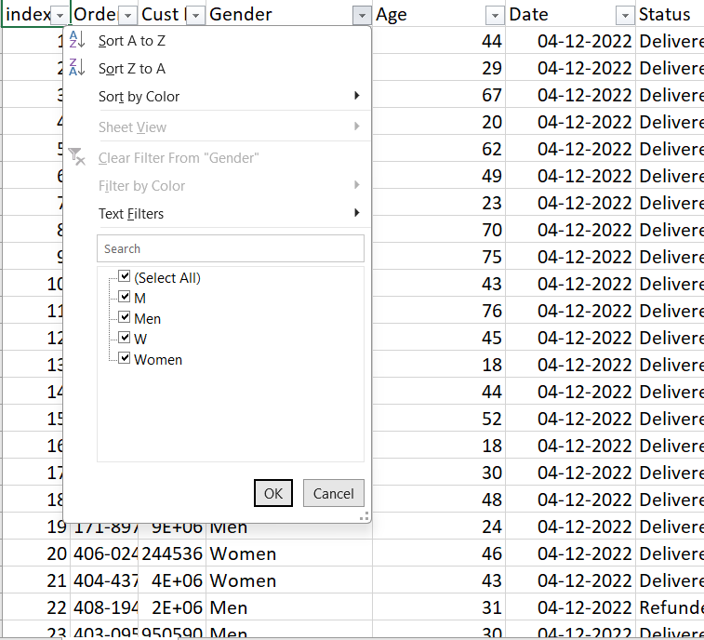
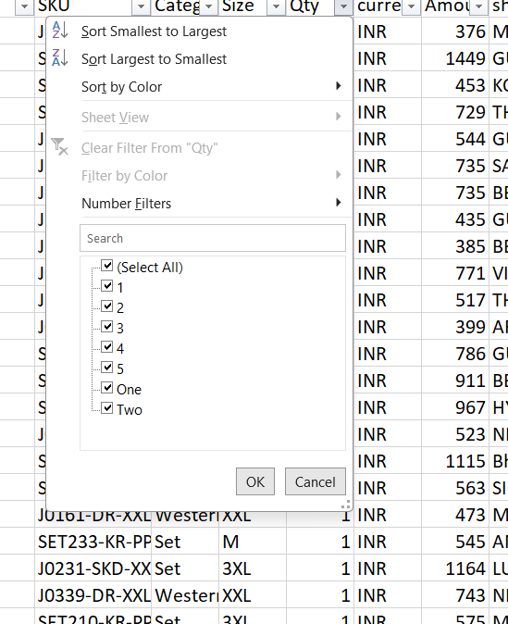
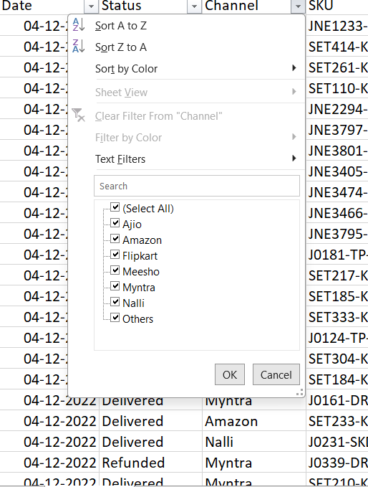

Slide 6


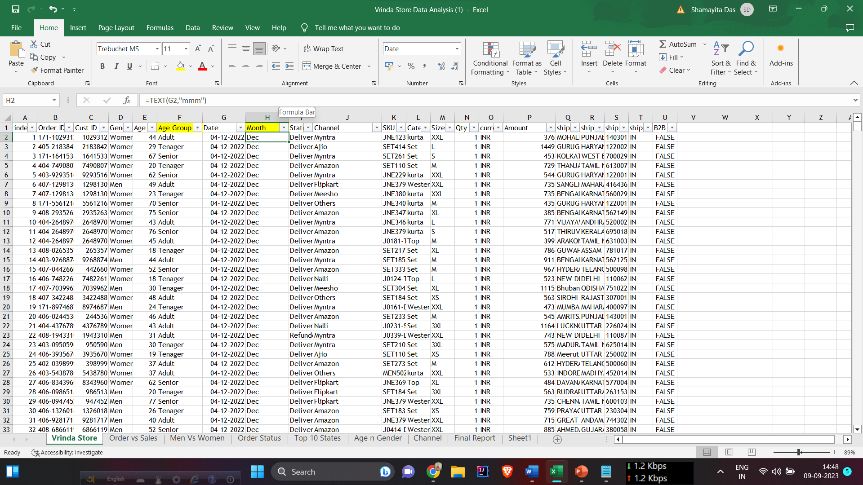
Data Processing
A series of calculations or actions that perform on a given set of data to produce a desired result.

Slide 7
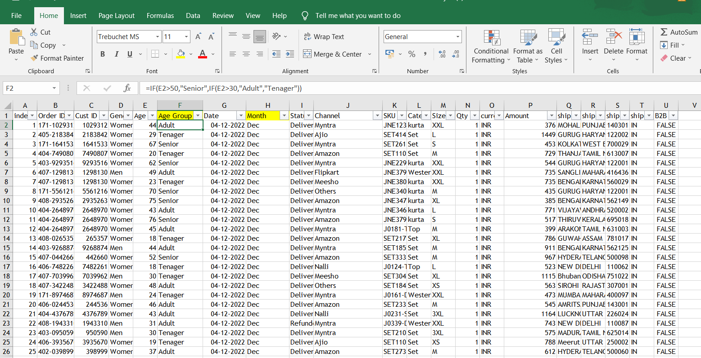

Slide 8

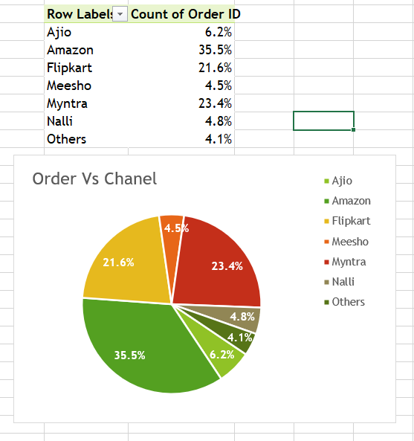
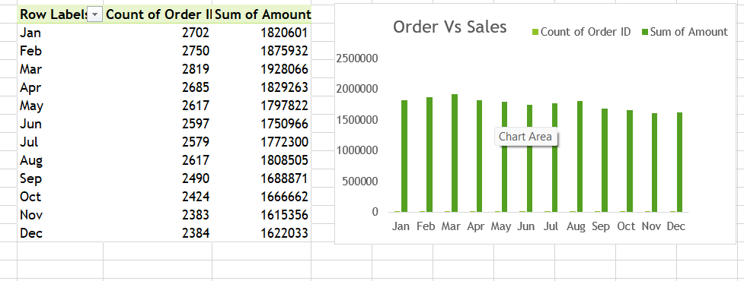
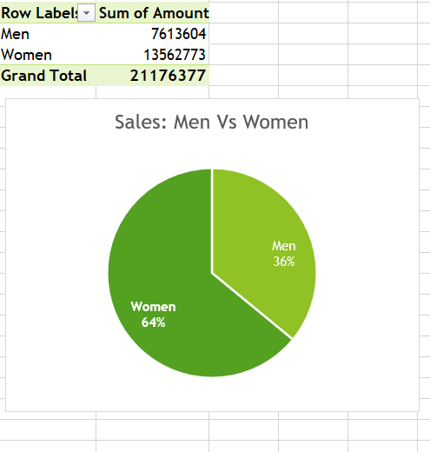
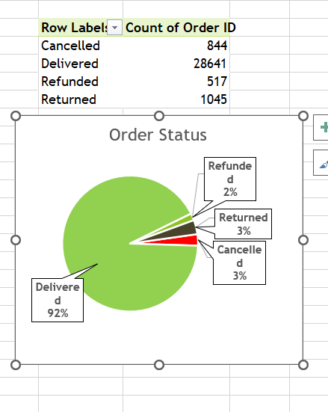
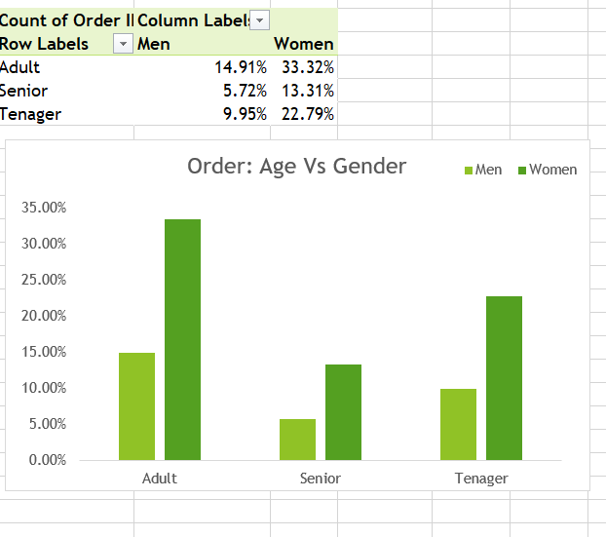
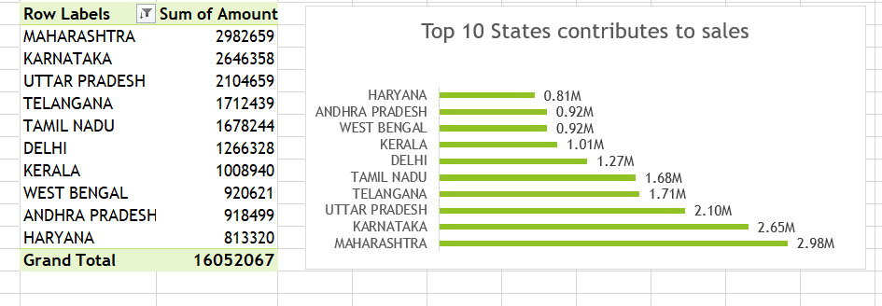
Data Visualization

Slide 9

The Final Interactive Dashboard

Slide 10
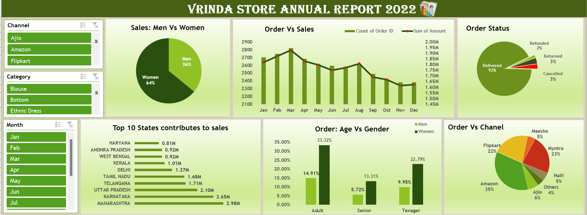

Slide 11


Insights
Women are more likely to buy as compared to men.
Maharashtra, Karnataka, and Uttar Pradesh are the top three states.
The senior age group (30-49yrs) is max contributing.
Amazon, Flipkart, and Myntra channels are max contributing.

